Slide 1
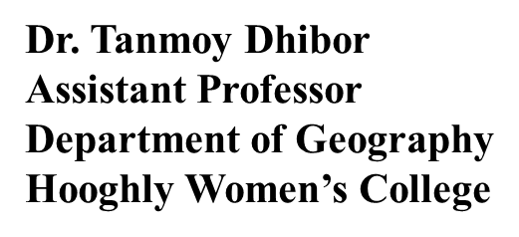
CC1 - GEOTECTONICS AND GEOMORPHOLOGY
Unit 1: Geotectonics
4. Plate Tectonics: Processes at constructive, conservative, destructive boundaries and hotspots: resulting landforms.

Slide 2
INTRODUCTION: • Earth's lithosphere is divided into mobile plates. • Plate tectonics describes the distribution and motion of the plates. Plate tectonics (from Greek τέκτων, tektōn "builder" or "mason") describes the large scale motions of Earth's lithosphere. The theory encompasses the older concepts of continental drift, developed during the ﬁrst half of the 20th century, and seaﬂoor spreading, understood during the 1960s.

Slide 3
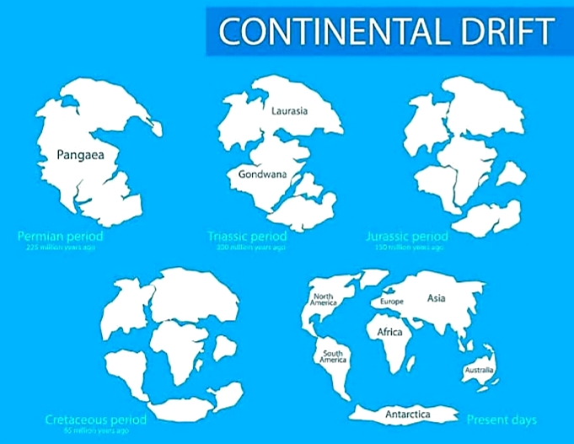
CONTINENTAL DRIFT: • Alfred Wegener proposed the hypothesis that the continents were once assembled together as a supercontinent he named Pangaea. • He noted that opposing coastlines were similar on opposite sides of the Atlantic Ocean, mountains belts matched when continents were reassembled, fossils matched between different continents, and climate evidence suggested continents were once in different locations. • Wegener's observations supported his hypothesis but he could not offer a suitable explanation for how the continents had moved around Earth. The concept of continental drift was proposed by Alfred Wegener. Wegener suggested that the earth's continents once formed a single super-continent landmass that he named Pangaea (Fig. 3). He suggested that Pangaea split apart into its constituent continents about 200 million years ago and the continents "drifted" to their current positions.

Slide 4
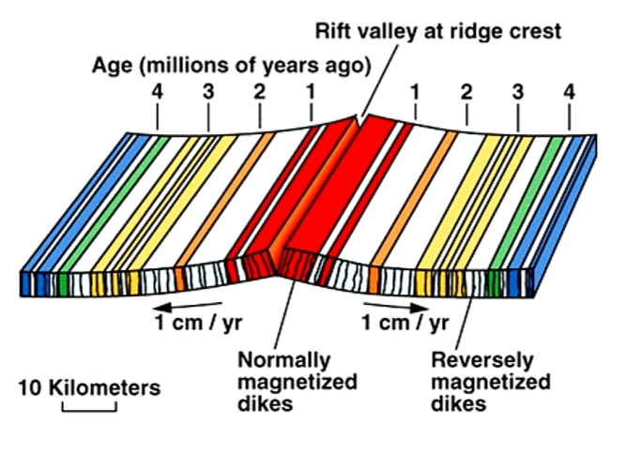
SEAFLOOR SPREADING: The ocean floor varies considerably in depth. An oceanic ridge system can be traced around the world. The deepest parts of the ocean (~10 km) are trenches found along the margins of some continents or adjacent to volcanic island chains. Sea-floor spreading proposed that rising magma was forming new oceanic crust along the oceanic ridges, the ocean floor was moving away from the ridges, and that old crust was destroyed at oceanic trenches. When the concept of seafloor spreading was matched with Wegener’s earlier idea of continental drift, the new theory of plate tectonics was born .

Slide 5
PLATE TECTONICS: • Earth's lithosphere is divided into a series of major and minor mobile plates. • Plates move at rates of centimeters per year. • Plates may be composed of continental and/or oceanic lithosphere. • The destruction of oceanic lithosphere below oceanic trenches explains the occurrence of earthquakes and volcanoes adjacent to trenches. The theory of plate tectonics proposes that the lithosphere is divided into eight major plates (North American, South American, Pacific, Nazca, Eurasian, African, Antarctic, and Indian-Australian) and several smaller plates (e.g., Arabian, Scotia, Juan de Fuca) that fit together like the pieces of a jigsaw puzzle .

Slide 6
THE PRINCIPAL ELEMENTS IN THE THEORY OF PLATE TECTONICS: The plates are in motion, moving away from ridges and toward trenches. Plates descend into the mantle below trenches in regions termed subduction zones. Plates typically contain both oceanic and continental lithosphere. Oceanic lithosphere is continually created and destroyed. Continental lithosphere cannot be destroyed but continents can be subdivided and assembled into supercontinents. Interactions at plate boundaries cause volcanic activity and earthquakes. EARTHQUAKES AND VOLCANOES ARE ASSOCIATED WITH CONVERGENT PLATE BOUNDARIES: The depth of earthquakes becomes progressively deeper underlying ocean trenches. Prior to the sea-floor spreading hypothesis there was no obvious explanation for the presence of these "Wadati-Benioff" zones. Earthquakes occur because of physical changes in the descending plate as it pushes into the asthenosphere. The oceanic lithosphere in the descending plate was heated to form magma which in turn generated volcanoes.

Slide 7
MAJOR PLATES:
The main plates are
African Plate covering Africa - Continental plate
Antarctic Plate covering Antarctica - Continental plate
Australian Plate covering Australia - Continental plate
Indian Plate covering Indian subcontinent and a part of Indian Ocean - Continental plate
Eurasian Plate covering Asia and Europe - Continental plate
North American Plate covering North America and north-east Siberia - Continental plate
South American Plate covering South America - Continental plate
Paciﬁc Plate covering the Paciﬁc Ocean - Oceanic plate
Notable minor plates include the Arabian Plate, the Caribbean Plate, the Juan de Fuca Plate, the Cocos Plate, the Nazca Plate, the Philippine Plate and the Scotia Plate.
TYPES OF PLATE BOUNDARY :
Divergent plate boundary - where plates move apart.
Convergent plate boundary - where plates converge.
Transform plate boundary - where plates slide past each other.

Slide 8
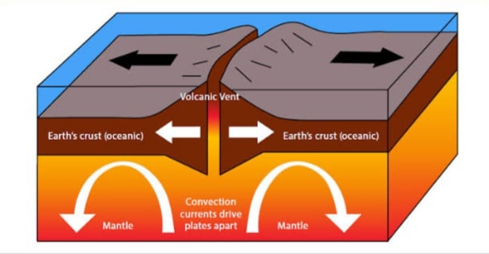
DIVERGENT BOUNDARIES: Divergent boundaries occur where two plates slide apart from each other. Ocean ridges and subduction zones are boundaries between plates of lithosphere. A gap is created when oceanic lithosphere separates along the oceanic ridge. The gap is filled by magma that rises from the asthenos- phere. The magma cools and solidifies to create new oceanic lithosphere. Mid-ocean ridges (e.g., Mid-Atlantic Ridge) and active zones of rifting (such as Africa's Great Rift Valley) are both examples of divergent boundaries.

Slide 9
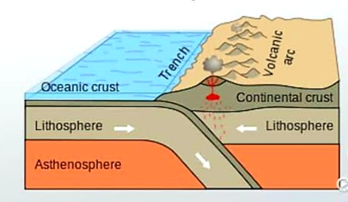
CONVERGENT PLATE BOUNDARIES: Convergent boundaries (or active margins) occur where two plates slide towards each other commonly forming either a subduction zone (if one plate moves underneath the other) or a continental collision (if the two plates contain continental crust). Deep marine trenches are typically associated with subduction zones. The subducting slab contains many hydrous minerals, which release their water on heating; this water then causes the mantle to melt, producing volcanism. Examples of this are the Andes mountain range in South America and the Japanese island arc. Convergent boundaries come in three varieties depending upon the type of lithosphere that is juxtaposed across a subduction zone.

Slide 10
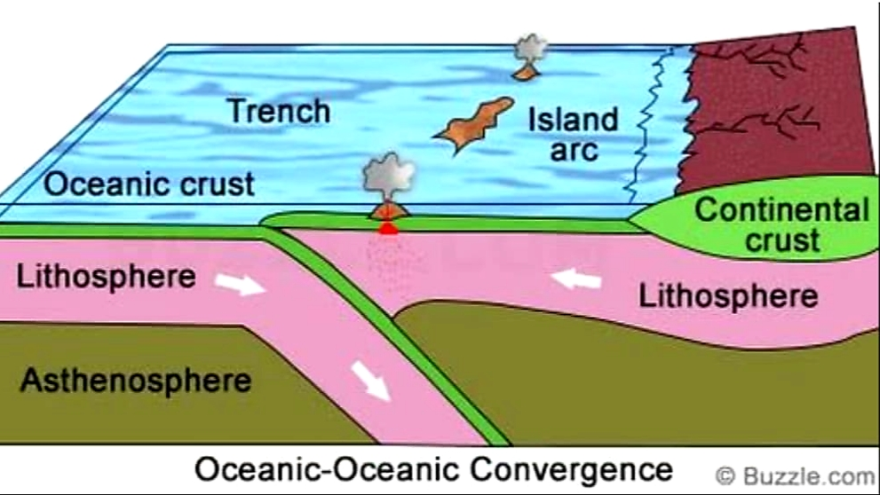
Oceanic Plate Vs. Oceanic Plate Convergence : The older of the two plates descends into the subduction zone when plates of oceanic lithosphere collide along a trench. The descending plate carries water-filled sediments from the ocean floor downward into the mantle. The presence of water alters the physical and chemical conditions necessary for melting and causes magma to form. The magma rises up through the overriding oceanic plate, reaching the surface as a volcano. As the volcano grows, it may rise above sea level to form an island

Slide 11
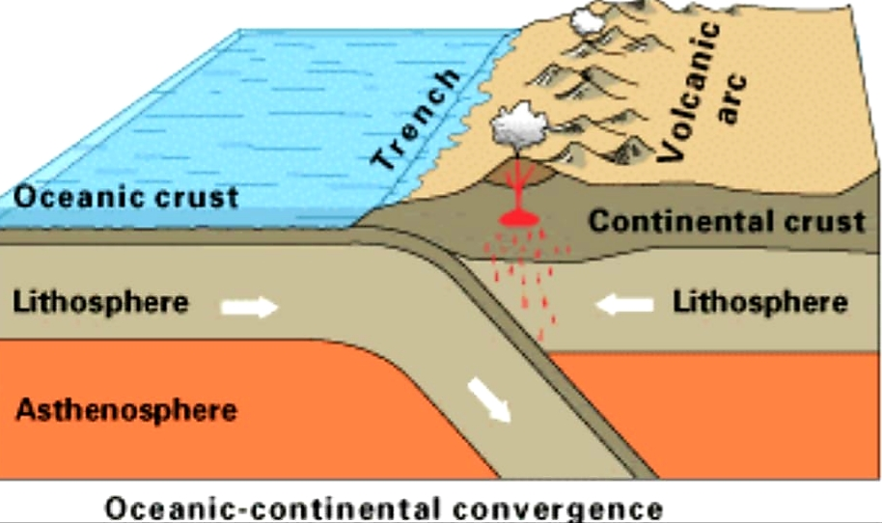
Oceanic Plate vs. Continental Plate Convergence: When oceanic lithosphere collides with continental lithosphere, the oceanic plate will descend into the subduction zone. Oceanic lithosphere is denser than continental lithosphere and is therefore consumed preferentially. Continental lithosphere is almost never destroyed in subduction zones.

Slide 12
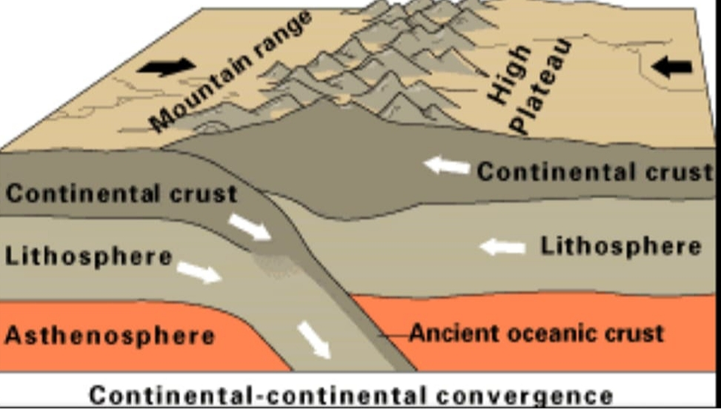
Continental Plate vs. Continental Plate Convergence: The tallest mountains in the world were formed (and continue to grow) as a result of continental collision. The Himalayan mountains mark the boundary between the Indian and Eurasian plates . The collision of the plates began over 40 million years ago when India smashed into the belly of Asia. Continental lithosphere is relatively light and is deformed adjacent to subduction zones rather than consumed.

Slide 13
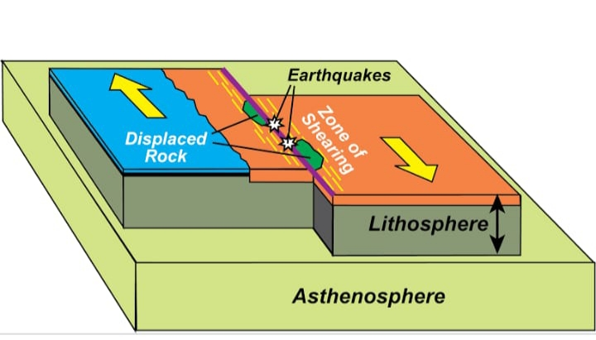
TRANSFORM PLATE BOUNDARIES: Transform boundaries occur where plates slide or, perhaps more accurately, grind past each other along transform faults. The relative motion of the two plates is either sinistral (left side toward the observer) or dextral (right side toward the observer). The San Andreas Fault in California is one example.

Slide 14
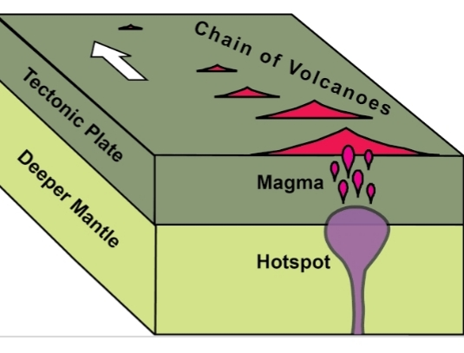
HOT SPOT :
hot spot is an area on Earth over a mantle plume or an area under the rocky outer layer of Earth, called the crust, where magma is hotter than surrounding magma. The magma plume causes melting and thinning of the rocky crust and widespread volcanic activity. In geology, the places known as hotspots or hot spots are volcanic regions thought to be fed by underlying mantle that is anomalously hot compared with the surrounding mantle.
Examples include the Hawaii, Iceland and Yellowstone hotspots. A hotspot's position on the Earth's surface is independent of tectonic plate boundaries, and so hotspots may create a chain of volcanoes as the plates move above them.

